Slide 1

Web Science Application Development
Jason Kuruzovich

Slide 2

Part 2: O
Feel free to reach out for help
Book a meeting:
https://bit.ly/jason-rpi
Rensselaer Polytechnic Institute
kuruzj@rpi.edu
518-698-9910
Jason Kuruzovich, PhD
Associate Professor of Business

Slide 3
Next Parts of Class
Core Engineering Pillars
Authentication & Authorization
Testing (Unit & Integration)
Deployment (Architecture & CI/CD Pipelines)
Security Hardening (DOS/Rate Limiting)
Agentic Systems (LangChain & Tooling)
In Parallel, We Will:
Deepen our understanding of React fundamentals and patterns
Compare and evaluate modern web frameworks (e.g., Flask)
Connect architectural decisions to real-world tradeoffs

Slide 4
Authentication Learning Objectives
By the end of class, students should be able to:
Explain the difference between Authentication vs Authorization
Describe row-level security (RLS) and why it matters
Implement basic email/password auth with Supabase
Enable OAuth login (Google)
Enforce per-user data isolation using RLS
Explain tradeoffs between JWT/session auth and OAuth

Slide 5
Readings
Industry Standards & Best Practice Guides
1. OWASP Authorization Cheat Sheet
2. WorkOS — OAuth and JWT Best Practices
3. Google Developers — OAuth2 Best Practices
4. Supabase Authentication
Notes:
OWASP Authorization Cheat Sheet
https://cheatsheetseries.owasp.org/cheatsheets/Authorization_Cheat_Sheet.html?utm_source=chatgpt.com
WorkOS — OAuth and JWT Best Practices
https://workos.com/blog/oauth-and-jwt-how-to-use-and-best-practices?utm_source=chatgpt.com

Slide 6
What is the difference between authentication and authorization?

Slide 7
Authentication vs Authorization
Authentication = Who are you?
Authorization = What are you allowed to do?
Example:
Login to Netflix (auth)
Only see your profile & watch history (authorization)

Slide 8
Authorization: Identify and protect critical system actions
Examples:
Create purchase order
Add vendor
Issue refund
Change pricing
Modify user roles
Export customer data
These require:
Strong authentication
Explicit authorization rules
Often additional controls (logging, approvals, MFA)

Slide 9
Core Concept: Identity
User logs in → system issues token (JWT or session)
Token sent with every request
Backend verifies token
Database may enforce identity (RLS)

Slide 10
What Is a JWT?
JSON Web Token (JWT): a compact, URL-safe token for transmitting claims
Structure:
Header — algorithm & token type
Payload — claims (user ID, role)
Signature — cryptographically signed data
Verified by server without storing session state

Slide 11
How do we securely store passwords?

Slide 12
Password Hashing with bcrypt
Never store passwords in plain text!
Hashing = one-way function (cannot reverse)
bcrypt adds a random salt automatically
bcrypt is intentionally slow (cost factor)
Flow:
Registration: password → bcrypt.hash() → store hash
Login: password + stored hash → bcrypt.compare() → true/false
Why not SHA-256?
Too fast — attackers can brute-force billions/sec
No built-in salt — vulnerable to rainbow tables

Slide 13
Access Tokens vs Refresh Tokens
Access Token
Short-lived (15 min – 1 hr)
Sent with every API request
Contains user claims (ID, role)
If stolen, limited damage window
Refresh Token
Long-lived (days – weeks)
Used only to get a new access token
Stored securely (httpOnly cookie or server-side)
Can be revoked to "log out" a user

Slide 14
Token Refresh Flow
1. User logs in → server returns access token + refresh token
2. Client sends access token with each API request
3. Access token expires (e.g., after 15 minutes)
4. Client sends refresh token to /api/refresh
5. Server verifies refresh token, issues new access token
6. If refresh token is expired/revoked → user must log in again
Benefits:
Users stay logged in without re-entering credentials
Compromised access tokens expire quickly
Server can revoke refresh tokens (unlike stateless JWTs)

Slide 15
How does OAuth fit in?

Slide 16
OAuth 2.0: Delegated Authentication
"Let users log in with Google/GitHub instead of a password"
Key Players:
Resource Owner — the user
Client — your app
Authorization Server — Google, GitHub, etc.
Resource Server — API that holds user data
Flow (Authorization Code):
App redirects user to provider's login page
User approves → provider sends auth code to your app
App exchanges code for access token (server-to-server)
App uses token to fetch user profile

Slide 17
JWT vs Session-Based Auth
Session-Based:
Server stores session in memory/database
Client gets a session ID cookie
Server looks up session on each request
Easy to revoke (delete the session)
JWT-Based:
Server does NOT store state — token is self-contained
Client stores token (localStorage, cookie, memory)
Server verifies signature on each request
Hard to revoke before expiry (need blocklist)
Trade-off: JWTs scale better; sessions revoke easier

Slide 18
Middleware: Protecting Routes
Middleware = function that runs before route handler
Authentication middleware pattern:
Extract token from Authorization header
Verify token signature and expiration
Attach user info to request object
Call next() to proceed, or return 401/403
401 Unauthorized — no token or invalid credentials
403 Forbidden — token present but invalid/expired
Apply per-route: app.get('/secret', authMiddleware, handler)

Slide 19
Security Best Practices
Passwords:
Always hash with bcrypt (cost factor >= 10)
Never log or return passwords in API responses
Tokens:
Keep access tokens short-lived
Use HTTPS in production (tokens travel in headers)
Store secrets in environment variables, not code
General:
Validate all input (username, password length)
Rate-limit login attempts to prevent brute force
Use generic error messages ("Invalid username or password")

Slide 20
Row-Level Security (RLS)
Problem: even authenticated users shouldn't see other users' data
RLS = database enforces per-user data isolation
How it works:
Database policy checks user ID on every query
SELECT * FROM todos → only returns YOUR todos
Even if app code has a bug, DB blocks unauthorized access
Supported by: Supabase (Postgres), Oracle, SQL Server
Defense in depth — don't rely solely on app-level checks

Slide 21
Lab 6: JWT Authentication Hands-On
Build a REST API with Express + JWT from scratch:
Set up Express server with health check
Implement user registration with bcrypt
Implement login that returns access + refresh tokens
Create middleware to protect routes
Add refresh token endpoint
Test everything with curl
Automated grading: push to GitHub → 8 tests run automatically
Check results in the Actions tab

Slide 22
How do we know our code actually works?

Slide 23
Types of Tests
Unit Tests
Test a single function in isolation
Example: does bcrypt.hash() produce a valid hash?
Fast — run hundreds in seconds
Integration Tests
Test components working together
Example: does POST /api/register actually store a user?
Slower — may need a running server or database
End-to-End (E2E) Tests
Test the full user flow from client to server
Example: register → login → access protected route
Slowest — but catches real-world bugs

Slide 24
The Testing Pyramid
Many unit tests (fast, cheap, isolated)
Fewer integration tests (moderate speed, test contracts)
Few E2E tests (slow, expensive, high confidence)
Why a pyramid?
Unit tests catch most bugs quickly
Integration tests verify components connect correctly
E2E tests confirm the system works as a whole
Anti-pattern: "ice cream cone" — too many E2E, too few unit

Slide 25
Testing in This Lab
Our autograder uses integration tests via curl
Each test sends an HTTP request and checks the response
Tests run sequentially: register → login → use token
This is exactly how you'd test a real API
What the 8 tests cover:
Health check (server is running)
Registration (happy path + duplicate handling)
Login (valid credentials + wrong password)
Protected route (no token, valid token, garbage token)
Key idea: tests document expected behavior
If the tests pass, the API contract is met

Slide 26
Automated Testing & CI/CD
CI = Continuous Integration
Every push triggers automated tests
Catch bugs before they reach production
GitHub Actions runs our autograder on every push
CD = Continuous Deployment
If tests pass, deploy automatically
If tests fail, block the deployment
Why this matters:
Manual testing doesn't scale
Automated tests give confidence to ship fast
Tests are a safety net — not a replacement for good design

Slide 27
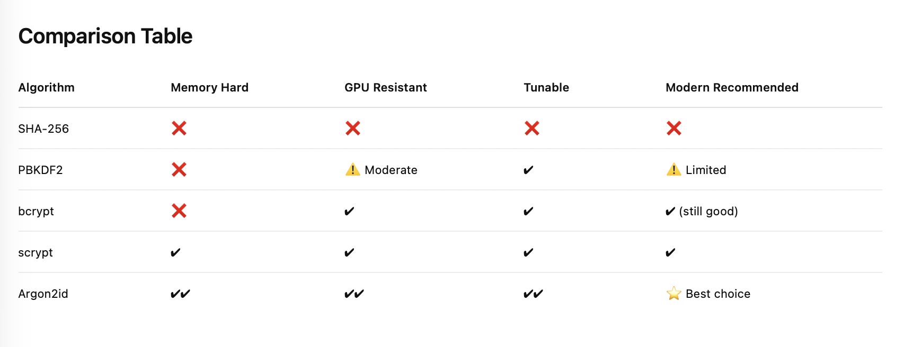
Additions: BCRYPT VS Others
“Argon2 is the newest algorithm among these and is currently considered to be the strongest password hashing algorithm available. It is designed to be memory-hard, meaning that it requires a lot of memory to compute. This makes it difficult for attackers to use specialized hardware like GPUs and ASICs to crack passwords. Argon2 has several parameters that need to be kept in mind when using it, such as the amount of memory to use and the number of iterations to perform.”
https://www.reddit.com/r/cryptography/comments/11tqci2/argon2_vs_bcrypt_vs_scrypt_vs_pbkdf2/

Slide 28
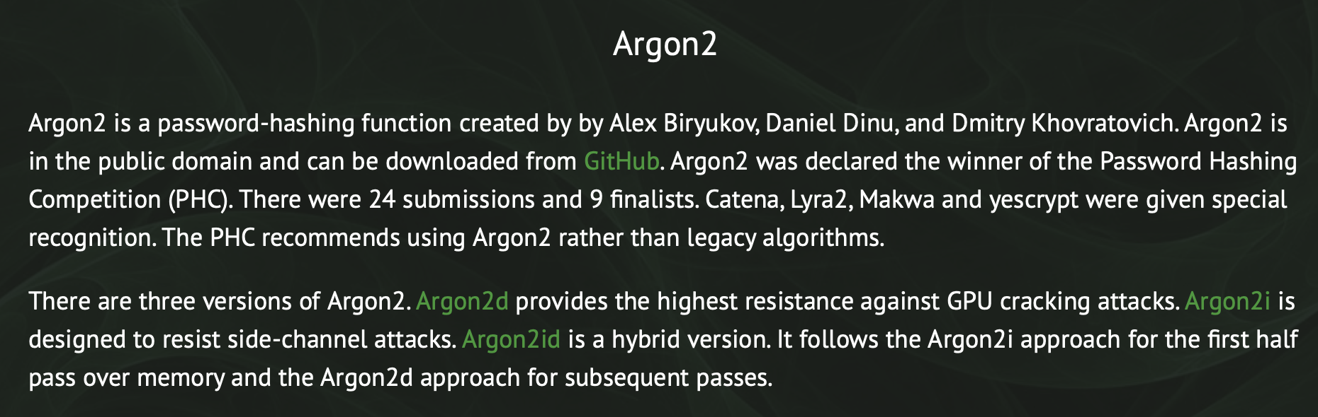

Slide 29
Access + Refresh Token Implementation
(Explicit Server + Client Code)
Built on JWT Authentication
Goal:
Access Token → React memory
Refresh Token → HTTP-only cookie (server controlled)

Slide 30
Full Architecture Overview
SERVER:
• Issues access token (short-lived)
• Issues refresh token (long-lived)
• Stores refresh token in HTTP-only cookie
CLIENT:
• Stores access token in React state
• NEVER stores refresh token in JS

Slide 31
SERVER: /api/login (Issues Both Tokens)
const accessToken = jwt.sign(payload, JWT_SECRET, { expiresIn: '15m' });
const refreshToken = jwt.sign(payload, REFRESH_SECRET, { expiresIn: '7d' });
// Store refresh token server-side (optional DB/in-memory)
refreshTokens.push(refreshToken);
// THIS stores refresh token in browser cookie
res.cookie('refreshToken', refreshToken, {
httpOnly: true,
secure: true,
sameSite: 'strict',
maxAge: 7 * 24 * 60 * 60 * 1000
});
res.json({ token: accessToken });

Slide 32
What Actually Stores the Refresh Token?
THIS LINE on the SERVER:
res.cookie('refreshToken', refreshToken, { httpOnly: true })
Browser receives Set-Cookie header →
Browser stores cookie automatically
React NEVER sees the refresh token.

Slide 33
CLIENT: Login Code
const res = await fetch('/api/login', {
method: 'POST',
headers: { 'Content-Type': 'application/json' },
credentials: 'include', // allows cookie to be set
body: JSON.stringify({ username, password })
});
const data = await res.json();
setToken(data.token); // Access token in memory

Slide 34
SERVER: /api/refresh
app.post('/api/refresh', (req, res) => {
const token = req.cookies.refreshToken;
if (!token) return res.sendStatus(401);
jwt.verify(token, REFRESH_SECRET, (err, user) => {
if (err) return res.sendStatus(403);
const newAccessToken = jwt.sign(
{ username: user.username },
JWT_SECRET,
{ expiresIn: '15m' }
);
res.json({ token: newAccessToken });
});
});

Slide 35
CLIENT: Silent Refresh on Page Load
useEffect(() => {
fetch('/api/refresh', {
method: 'POST',
credentials: 'include' // sends cookie automatically
})
.then(res => res.json())
.then(data => setToken(data.token));
}, []);
Browser automatically attaches refresh cookie.

Slide 36
Protected Route Call (Client)
fetch('/api/secret', {
headers: {
Authorization: `Bearer ${token}`
}
});
Access token explicitly sent in header.

Slide 37
Handling Expired Access Tokens
If /api/secret returns 403:
1. Call /api/refresh (cookie auto-sent)
2. Receive new access token
3. Retry original request
Refresh token never exposed to JS.

Slide 38
Logout Flow
CLIENT:
setToken(null);
fetch('/api/logout', { credentials: 'include' });
SERVER:
res.clearCookie('refreshToken');
revoke token in DB/in-memory store

Slide 39
Security Model Summary
XSS Protection:
Refresh token cannot be read by JavaScript
CSRF Protection:
sameSite='strict' on cookie
Access token sent manually in header
Access token short lifetime limits damage window

Slide 40
Backend as A Service
One alternate way is to have a full backend as a service
Firebase https://firebase.google.com
Supabase https://supabase.com
AWS Amplify https://aws.amazon.com/amplify/
What are advantages of backend as a service providers?
What are the drawbacks?

Slide 41
AWS Amplify
https://github.com/RPI-WS-spring-2026/amplify-vite-react-template

Slide 42
Backend as a Service (BaaS)
+ TypeScript Overview
Context: React + AWS Amplify Quickstart
What is BaaS?
Firebase | Supabase | AWS Amplify
Plus: What is TypeScript?

Slide 43
What is Backend as a Service (BaaS)?
BaaS = Cloud-managed backend infrastructure
Instead of building your own backend:
• Auth handled for you
• Database hosted for you
• APIs auto-generated
• File storage included
You focus on frontend + business logic

Slide 44
Core Services Provided by BaaS
1. Authentication (email, OAuth, MFA)
2. Database (SQL or NoSQL)
3. Auto-generated APIs
4. File storage
5. Hosting + CI/CD
6. Security rules & access control

Slide 45
Firebase (Google)
Database: Firestore (NoSQL, document-based)
Auth: Built-in providers
Cloud Functions + Hosting
Strengths:
• Very fast to start
• Strong real-time support
Tradeoff: NoSQL structure, vendor lock-in

Slide 46
Supabase
Open-source Firebase alternative
Database: PostgreSQL (SQL, relational)
Auto-generated REST + GraphQL APIs
Strengths:
• Real SQL database
• Open-source flexibility
Tradeoff: Slightly more setup

Slide 47
AWS Amplify
Built on AWS services (Cognito, AppSync, DynamoDB, S3)
Strong React integration
Provides:
• Authentication (Cognito)
• GraphQL / REST APIs
• Storage (S3)
• Hosting + CI/CD
Enterprise-ready and scalable

Slide 48
How Amplify Works in React
Install Amplify libraries
Configure backend via CLI or Amplify Studio
Example:
import { Amplify } from 'aws-amplify';
import config from './amplifyconfiguration.json';
Amplify.configure(config);

Slide 49
What is TypeScript?
TypeScript = JavaScript + Static Types
Developed by Microsoft
Adds compile-time type checking
Compiles into standard JavaScript
Improves safety + developer experience

Slide 50
Why TypeScript in Amplify?
Amplify generates typed models
Better IDE autocomplete
Catches errors before runtime
Example:
function greet(name: string): string {
return 'Hello ' + name;
}

Slide 51
JavaScript vs TypeScript
JavaScript:
let age = 25;
TypeScript:
let age: number = 25;
Prevents: age = 'twenty five'; ❌

Slide 52
When to Use BaaS vs Custom Backend
Use BaaS when:
• MVP / startup
• Small team
• Need rapid deployment
Use custom backend when:
• Complex business logic
• Deep infrastructure control required

Slide 53
Summary
BaaS = Managed backend infrastructure
Firebase → Fast, NoSQL
Supabase → SQL, Open-source
Amplify → AWS ecosystem integration
TypeScript = Safer, typed JavaScript
Ideal for modern React apps

